Slide 1
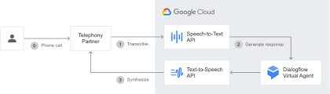
What is Google Cloud Text-to-Speech (T TS)
Google Cloud Text-to-Speech (TTS) is a cloud-based service that converts written text into natural-sounding speech. It's like having a robot that can read out loud for you!

Slide 2
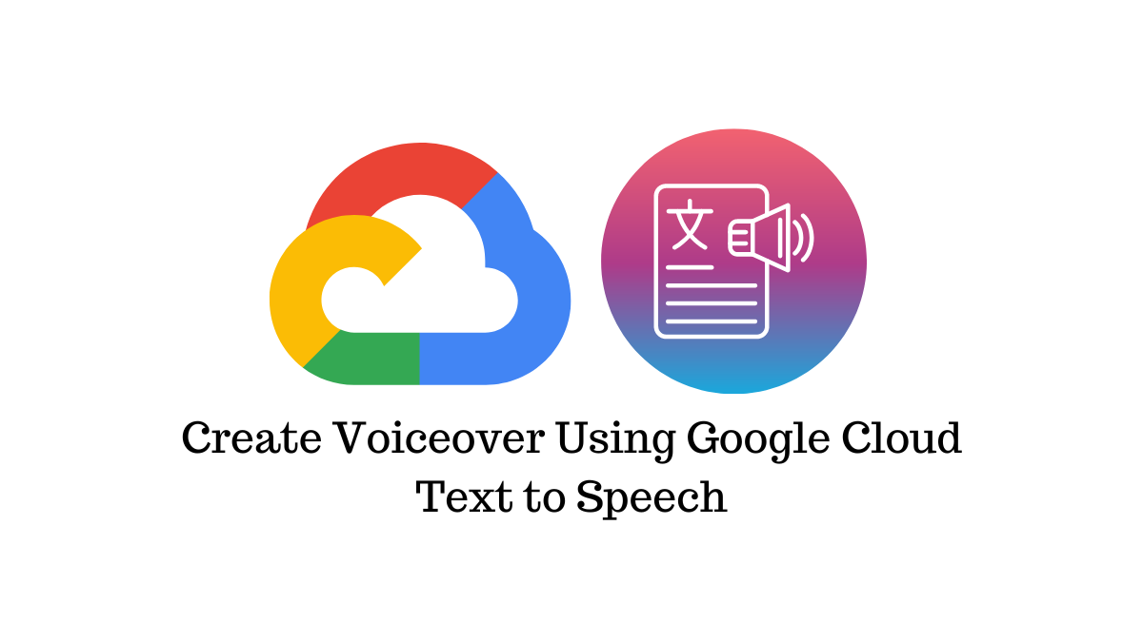

Slide 3
Why Use Google Cloud TTS?
Convenience: TTS allows you to create audio content without needing to record audio files manually.
Scalability: With TTS, you can generate audio files in bulk, making it perfect for large-scale applications.

Slide 4
Customization: You can choose from a variety of voices, languages, and speaking styles to fit your needs.
Cost-effective: TTS is a cost-effective solution compared to recording and editing audio files manually.

Slide 5
How Does it Work
Here's a high-level overview of how Google Cloud TTS works:
Text Input: You provide the written text you want to convert to speech.
Language Selection: You choose the language and voice you want to use for the audio output.
TTS Engine: The TTS engine processes the text and generates an audio file using the selected voice and language.
Audio Output: The generated audio file is returned to you, ready for use in your application.

Slide 6
Features
Multi-language support: TTS supports over 100 languages and dialects.
Custom voices: You can create custom voices tailored to your brand or application.

Slide 7
SSML support: TTS supports Speech Synthesis Markup Language (SSML), which allows for advanced audio customization.
Real-time synthesis: TTS can generate audio files in real-time, making it perfect for applications that require immediate audio output

Slide 8
Use Cases
Audiobooks and podcasts: TTS can be used to generate audio content for audiobooks, podcasts, and educational materials.
Virtual assistants: TTS can be used to power virtual assistants, such as Google Assistant, Amazon Alexa, and more.

Slide 9
Accessibility: TTS can be used to provide audio descriptions for visually impaired users, making digital content more accessible.
Marketing and advertising: TTS can be used to generate audio ads, voiceovers, and other marketing materials.

Slide 10
Pricing
voiceovers
Google Cloud TTS offers a free tier, as well as several paid tiers, depending on the number of characters you need to synthesize. The free tier includes:
1 million characters per month
4 million characters per day
100,000 characters per minute

Slide 11
Getting Started
Getting Started
To get started with Google Cloud TTS, follow these steps:
Create a Google Cloud account: Sign up for a free Google Cloud account if you haven't already.
Enable the TTS API: Enable the Cloud Text-to-Speech API in the Google Cloud Console.
Choose a programming language: Choose a programming language you want to use to interact with the TTS API (e.g., Python, Java, Node.js).
Start synthesizing: Start synthesi

